Slide 1
Project 2

Slide 2
The Idea
The idea is create a game that will draw a random card which has a random point to it and to roll a dice.
The multiplication value of both numbers will earn the use a random prize depending on how well they played.

Slide 3






Tools Used

Slide 4
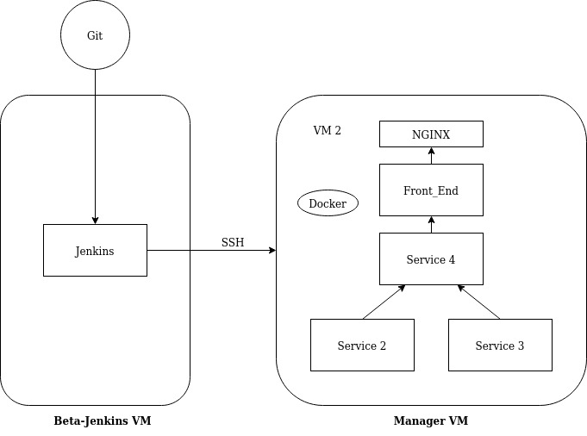
How it works?

Slide 5
├── Dockerfile
├── app.py
├── application
│ ├── __init__.py
│ ├── forms.py
│ ├── models.py
│ ├── routes.py
│ └── templates
│ ├── home.html
│ ├── layout.html
│ └── page-1.html
└── requirements.txt
Service 1
This Service contains the front-end of the application.
HTML
Jinja 2
Python
Request a dictionary called prize from Service 4
@app.route('/page-1', methods=['GET', 'POST'])
def draw():
form = DrawCard()
# card = ''
# roll = ''
prize = ''
if form.is_submitted():
serv4 = requests.post("http://service_4:5004/service_4")
if serv4.status_code == 200:
prize = serv4.json()['prize']
return render_template('page-1.html', title='Page 1', form=form, prize=prize)

Slide 6
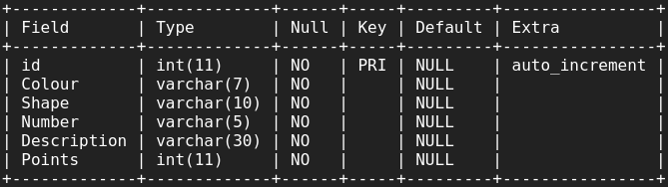
.
├── Dockerfile
├── app.py
├── application
│ ├── __init__.py
│ ├── models.py
│ └── routes.py
├── requirements.txt
Service 2
This Service contains a function that gets a random card from the database
Every card has been given a score from 1 to 52 which is how many points the card is worth and then it is stored in a Json dictionary

Slide 7
.
├── Dockerfile
├── app.py
├── requirements.txt
Service 3
This Service contains a function that generates a random number from 1 to 6 which will act as a dice from the game.
The value will also be stored as a json dictionary so it can be called later on by service 4
@app.route('/service_3', methods=['POST'])
def roll_dice():
roll = random.randint(1, 6)
return {'roll':'{}'.format(roll)}

Slide 8
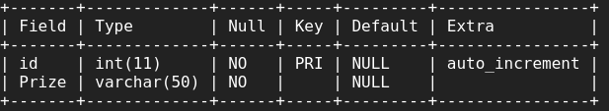
.
├── Dockerfile
├── app.py
├── application
│ ├── __init__.py
│ ├── models.py
│ └── routes.py
├── requirements.txt
Service 4
This Service contains a function that requests the values from the dictionary in service 2 and service 3 and multiplies them together.
Depending on what the multiplied value is, a random prize from the database

Slide 10
Rick | Likelihood | Solution
Lack of understanding with assignment brief | Low | When faced with the issue of not understanding the briefing, one of the best things to do is to read the assignment brief a few more time. This will allow familiarity with the brief and then the individual who set the assignment brief can be asked for clarification and understanding of the task
Planning | Medium | It is possible to start developing an application without planning but this is not advised as it will lead to human error and can lead to accidentally developing away from the users need and the scope of the project as a whole. The solution can be to use a kanban board software such as Trello in order to keep track of use cases,software design, completed tasks and uncompleted tasks.
No online connection | Medium | Online connection is not immediately because it is possible to write/code a whole application locally. But being only is very important especially if a cloud service or version control system is being used.

Slide 11
What can be improved?
Design
Display card/card images
Display dice roll
Expansion of Service
Game additions
Prize generator
SQL container

Slide 12
Problems faced?
Planning
Timing
Implementation
Testing

Slide 13
Conclusion
Planning
Create
Test
Deploy
Update

Slide 14
Questions?

